Slide 1
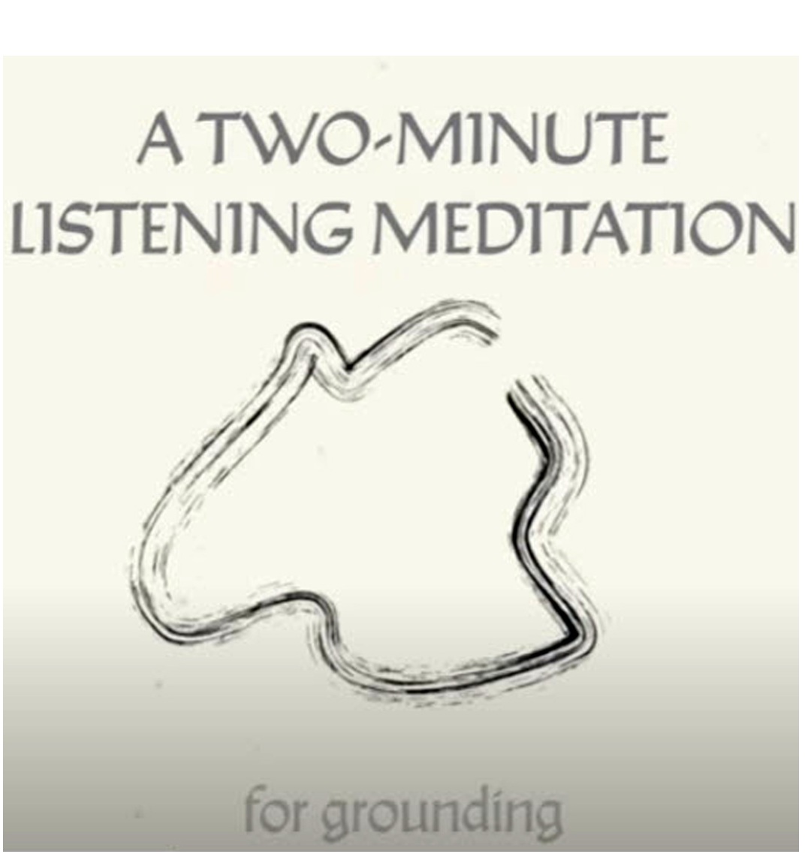

Slide 2
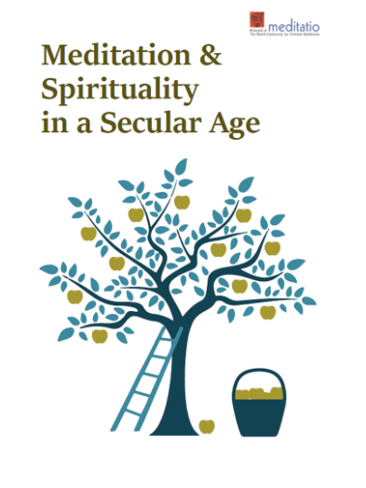
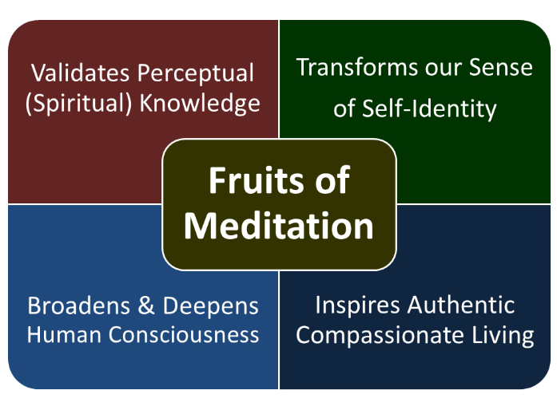
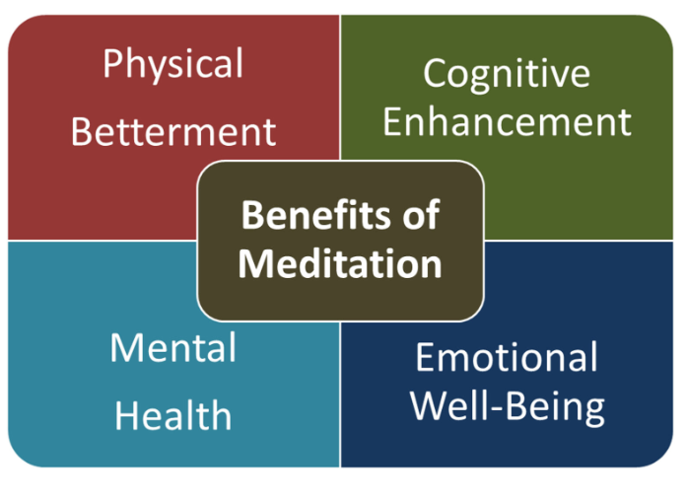

Slide 3
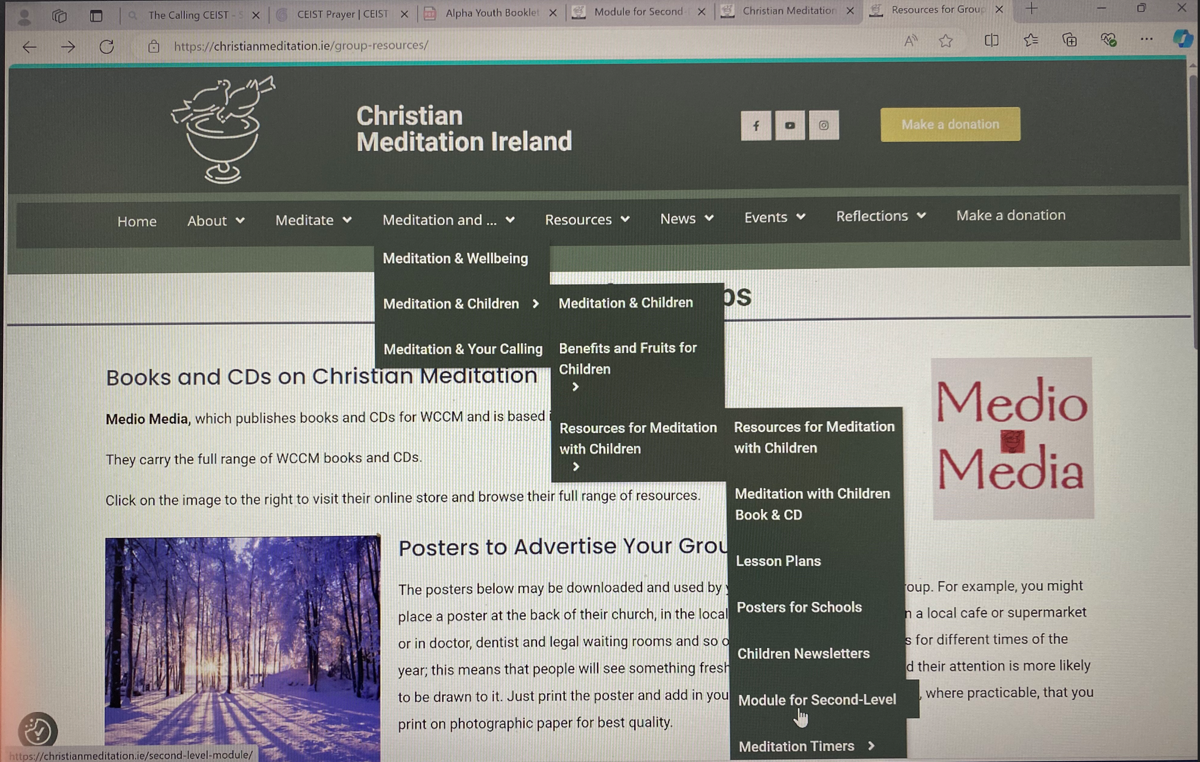
Christian Meditation Module for Second Level students designed by Dr. Noel Keating

Slide 5
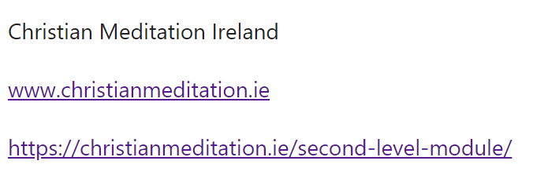
This is a draft module on meditation designed to be used with second-level students/ teenagers. The purpose of this document is to set out the draft programme as a sequence of lessons and to encourage teachers and others working with teenagers to test the materials in the classroom or other teenage setting and to share with one another, through me, their feedback on what works well, what does not and how the programme might be amended to make it more effective.
Area of Study: Spiritual, Social & Personal Development

